Slide 1
An Introduction to Kalman Filter

Slide 2
Overview
A conceptual view (scalar problem)
Kalman Filter Formula
Limitation of traditional Kalman Filter and imperfect solution
Homework (if you are interested)

Slide 3
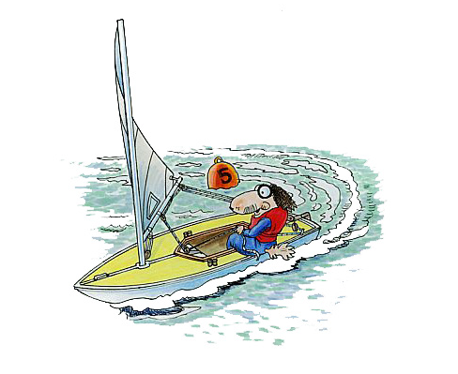
Conceptual View (One-dimension)
Model
Where am I?
Observation
Estimate my speed, I estimate I am at position = 500km from my origin
Somewhat uncertain,
Expressed with standard deviation
I also have a very old GPS, it tell me my position at y=600km, with a standard deviation
km
y
km
Combine both pieces of information to get the best estimation of my location.
Somewhere between, but close to GPS location; why?
500 km
600 km

Slide 4
Mathematical Formulation
is our best estimation with uncertainty
k is the unknown coefficients
We want to minimize the uncertainty , i.e. standard deviation

Slide 5
Mathematical Formulation
Here we assume the
Give you the minimal

Slide 6
Mathematical Formulation
Uncertainty was reduced !
i.e.
Observation
analysis
model
Gain
innovation

Slide 7
Statistical View
Uncertainty
Your prediction!

Slide 8
GPS measurement !
You prediction!

Slide 9
Best Estimation when combining your prediction and measurement
Corrected mean is the new optimal estimate of position
New uncertainty is smaller than either of the previous two variances

Slide 10
Flow chart of the process---doing previously repeatedly
GPS measurements
t = i
t = i +ΔT
Filter
xª(i) = x^{f}(i) + K[y(i) - x^{f}(i)]
xª(i +ΔT ) = x^{f}(i +ΔT ) + K[y(i +ΔT ) - x^{f}(i +ΔT )]
x^{f}(i)
xª(i)
i, i +ΔT
x^{f}(i +ΔT )
xª(i +ΔT )
i +ΔT, i +2ΔT
x^{f}(i +2ΔT )
Your estimation
x^{f}(i +ΔT ) = M_{i → i+ΔT} [xª(i)]
x^{f}(i +2ΔT ) = M_{i +ΔT → i+2ΔT} [xª(i +ΔT )]
x^{f}: forecast ;
xª: improved estimation;
y: measurement;
K: Gain;
i, i+ΔT: time step
ΔT: assimilation interval
M_{i → i+ΔT}: model integration

Slide 11
Without and With assimilation

Slide 12
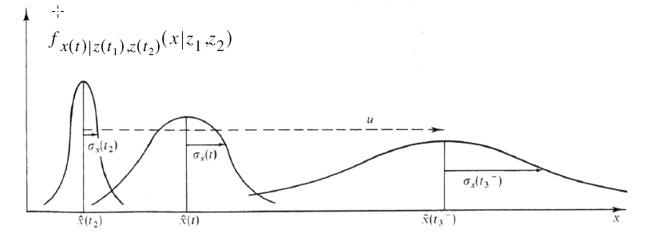
Long-term prediction without assimilation?
Larger and larger error and uncertainty

Slide 13
In general case: not scalar
Given the linear dynamical system:
the Kalman Filter is a recursion that provides the
“best” estimate of the state vector x.

Slide 14
In general case :not a scalar
Kalman Filter
Step 1. Model prediction: x^{f} is estimate based on
Noise (v) with covariance Q
this is your estimation of the error propagation.
Step 2. Calculate Kalman Gain:
step 3:correction of model state by KF analysis
this is your new estimation of the error covariance, reduced from to

Slide 15
In general case: not a scalar
x^{f}: forecast [N×1] ; a state vector ( a scalar before : your prediction of your location 1-D)
xª: (analysis) [N×1] ; a state vector (a scalar before: 1-D location)
y: observation [N_{o}×1] ; a observationa vector (a scalar before: gps measurement location 1-D)
K: Kalman gain [N×N_{o}] ; a matrix (a scalar before : )
Observation
H is the observation operator , interpolate the x^{f} to y ,this is because the observation size are usually smaller than your model state vector
analysis
model
Gain
innovation

Slide 16


Scalar case
General case
If we are sure about measurements:
  Measurement error covariance (R) decreases to zero
  K decreases and weights residual more heavily than prediction
If we are sure about prediction
  Prediction error covariance P ^{f} decreases to zero
  K increases and weights prediction more heavily than residual

Slide 17
Flow chart of the process---doing previously repeatedly
Measurements y
t = i
t = i +ΔT
Filter
xª(i) = x^{f}(i) + K[y(i) - H x^{f}(i)]
xª(i +ΔT ) = x^{f}(i +ΔT ) + K[y(i +ΔT ) - H x^{f}(i +ΔT )]
x^{f}(i)
xª(i)
i, i +ΔT
x^{f}(i +ΔT )
xª(i +ΔT )
i +ΔT, i +2ΔT
x^{f}(i +2ΔT )
Your estimation
x^{f}(i +ΔT ) = M_{i → i+ΔT} [xª(i)]
x^{f}(i +2ΔT ) = M_{i +ΔT → i+2ΔT} [xª(i +ΔT )]
x^{f}: forecast [N×1] ; model prediction
Xª: KF analysis condition [N×1] ;
y: observation [N_{o}×1] ; from field measurements
K: Kalman gain
ΔT: assimilation interval
M_{i → i+ΔT}: model integration from time i to i+ ΔT

Slide 18
Summary
Recursive data processing algorithm
Generates optimal estimate of desired quantities given the set of measurements
Optimal?
  For linear system and white Gaussian errors, Kalman filter is “best” estimate based on all previous measurements
  For non-linear system optimality is ‘qualified’
Recursive?
  Doesn’t need to store all previous measurements and reprocess all data each time step

Slide 19
Limitation
Weak nonlinear system (Extended Kalman Filter)
Computation loads
  P=O(1e6) x O(1e6) matrix
  Reduced Rank Kalman Filter (project to leading error subspace O(1e2) from EOF analysis and doing KF in model error subspace then project back)
  Ensemble Kalman Filter (Represents error statistics using an ensemble of model states.)
(see Chen etc. 2009 for coastal ocean idealized case)

Slide 20
Homework (if you are interested)
Consider you are in a room: your estimation is the temperature is constant (you can have your first guess with any temperature)
You have a thermometer, with a known variance (uncertainty) = 1
We know the true room temperature is 10 ºC with some perturbation, variance 0.25
Using matlab/others to construct a KF model, show your model states analysis and error variance convergence in KF
Assuming all error distribution is Gaussian

Slide 21
Analysis state is improved, and error variance converged

Slide 22
Overestimate the model error variance by a factor of 10

Slide 23
Underestimate the model error variance by a factor of 10

Slide 24
References
Greg Welch and Gary Bishop: An Introduction to the Kalman Filter
Buehner, M., and P. Malanotte-Rizzoli, Reduced-rank Kalman filters applied to an idealized model of the wind-driven ocean circulation, JGR
Evensen 2003, Ocean Dynamics, Vol 53, No 4 The Ensemble Kalman Filter: Theoretical formulation and practical implementation

