Slide 1
MAR513 Lecture 5: Finite-Volume Methods
Unlike finite-difference and finite-element methods, the computational domain in the finite-volume methods is divided into many control volumes (CV) and the governing equations are solved in its integral form in individual control volumes.
For example:
(7.1)
Structured grids
1. Assign the elevation at the center of each rectangular control volume;
2. Define that outflow is positive and inflow is negative;
3. Calculate the net flux
N
vD
W
uD
uD
E
vD
S

Slide 2
Approximation of volume integrals
The first order upwind scheme
n-1 n n+1
The second order central scheme

Slide 3
Consider an arbitrary function like
On the east side, for the first order approximation,
nw
n
ne
For the second order approximation,
w
P
e
sw
s
se
For the fourth order approximation,
Consider an arbitrary function like
For the first order approximation
For the second order approximation,

Slide 4
The fourth order approximation can be obtained by using the bi-quadratic shape funcion:
Need 9 coefficients,which can determined by fitting the function to the value of f at 9 locations (nw,w,sw, n, p,s, ne,e,and se).
For the cell-centered grids, the value at P point is known,but values at other points must be obtained by interpolation from surrounding cell-centered nodes.
Comments;
Structured grid finite-volume model is a special type of the finite-difference methods and they always can convert from one to another. So, little efforts need to make to convert a finite-difference model to a finite-volume model under structured grids.

Slide 5
3. Popular unstructured triangular FVM grid in CFD:
Cell-centered
Cell-vertex overlapping
Cell-vertex median
Characteristics of the oceanic motion:
Free surface----How to calculate accurately the integral form of the surface pressure gradient forcing?
Steep bottom topography----How to ensure the mass conservation in a two mode model system?
Open boundary conditions----How to minimize the wave energy reflection at open boundaries?

Slide 6
Cell vertex median grid
Cell-centered
Cell-vertex-centered
A Grid: All variables (ζ,,u,v, ω, θ, s..) at nodes
B Grid: All variables (ζ,,u,v, ω, θ, s..) at centroids
C Grid:
ζ, ω, θ, s, K_{m}, K_{h}…
Advantage:
1) Simple
2) Guarantee the mass conservation for tracers
Advantage:
1) Simple
2) Better to advection calculation
Advantage:
Combine the best of A and B Grids;
Easy to ensure the mass conservation for tracers
Easy to introduce the mass conservative open boundary conditions
Disadvantage:
The accuracy of the surface elevation gradient forcing is sensitive to the shape of the control element (due to interpolation)
Hard to ensure the mass conservation at open boundaries
Disadvantage:
Hard to guarantee The accuracy of the surface elevation gradient forcing
Hard to ensure the mass conservation at open boundaries
Hard to ensure the mass conservation for tracer calculation
FVCOM

Slide 7
1. Advection Scheme
and C = 1
Δt = 0.05, Δx=0.1
Upwind finite-difference stream
Central finite-difference stream
FVCOM finite-volume flux scheme

Slide 8
Δt = 0.005, Δx=0.01
Upwind finite-difference stream
Central finite-difference stream
FVCOM finite-volume flux scheme

Slide 9
Wind-induced oscillation
Wind is suddenly imposed at initial
Linear, non-dimensional equations:
Wind
r_{o}=67.5 km
d=75 m
where
and
Solution:
Reference:
Csanady ( 1968)
Birchfield (1969)

Slide 10
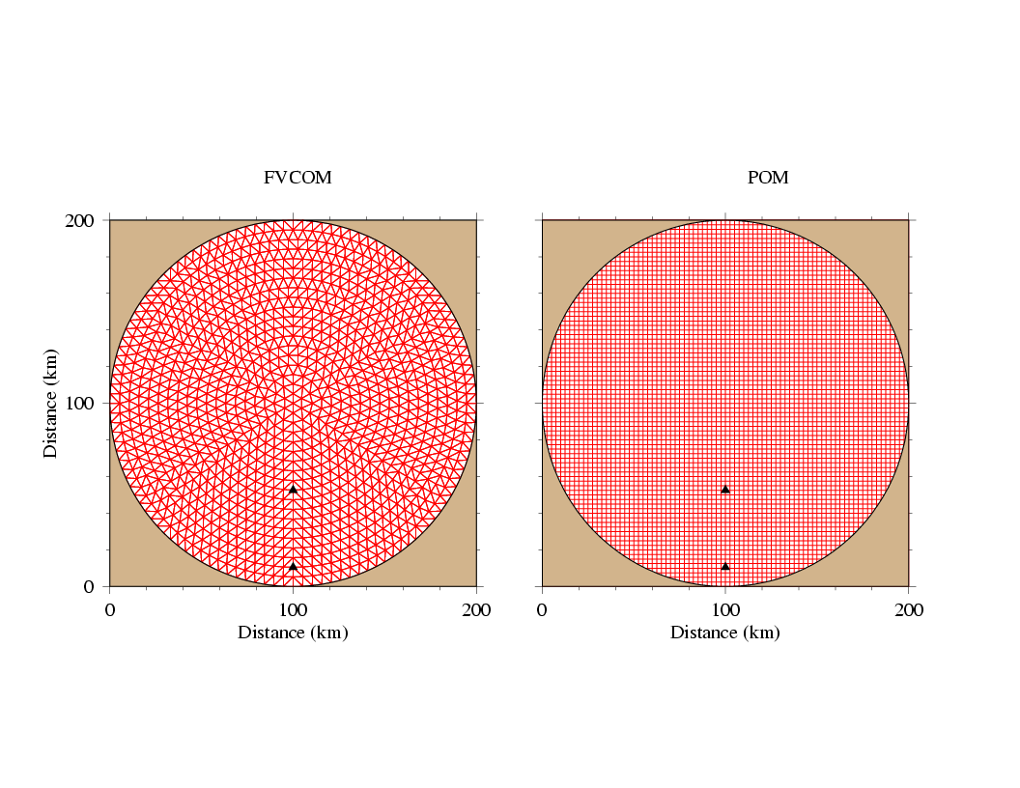
Unstructured (FVCOM)
Structured (POM)

Slide 11
Water elevation
Alongshore transport

Slide 12
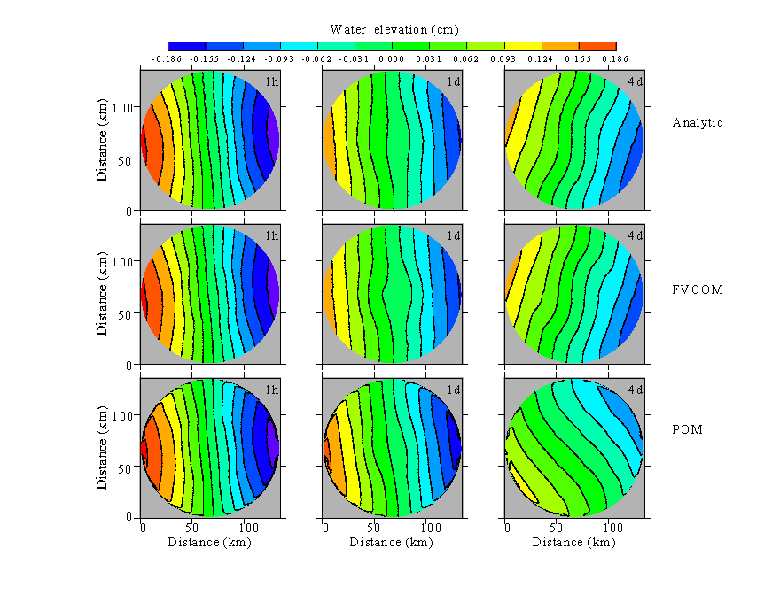

Slide 14
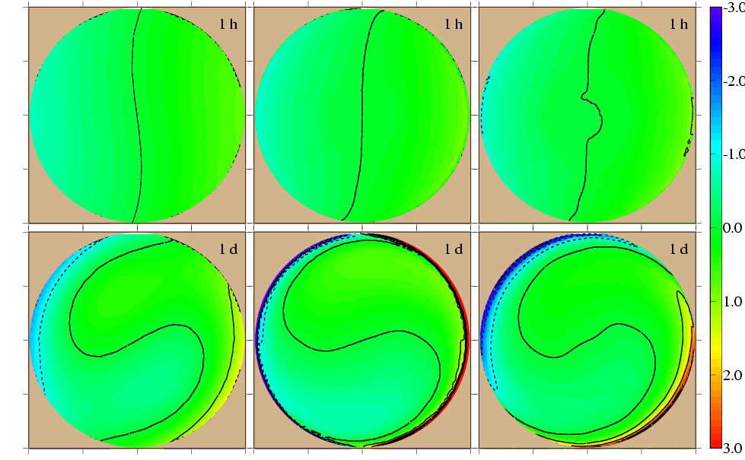
Radial mode: k=1, 2: gravity waves, k=3: topographic wave
Birchfield and Hickie (1977) JPO
Analytical
FVCOM (5 km)
POM (2.5 km)
1 h
1 d

Slide 15
5 days
FVCOM (5 km)
POM (2.5 km)
ζ: Elevation
: Current

Slide 18
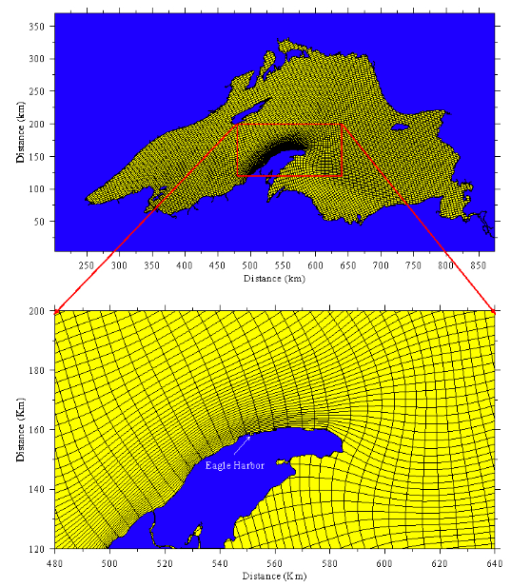
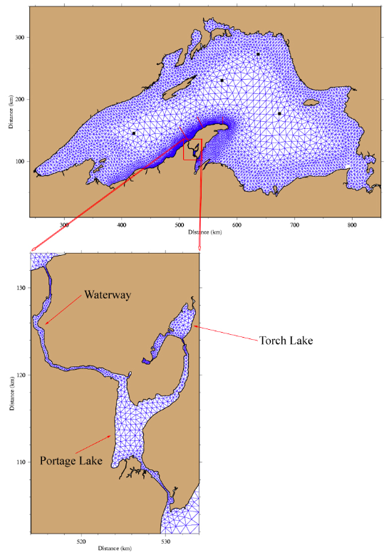
Structured (POM)
Unstructured (FVCOM)

Slide 19
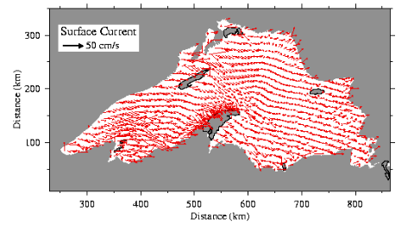
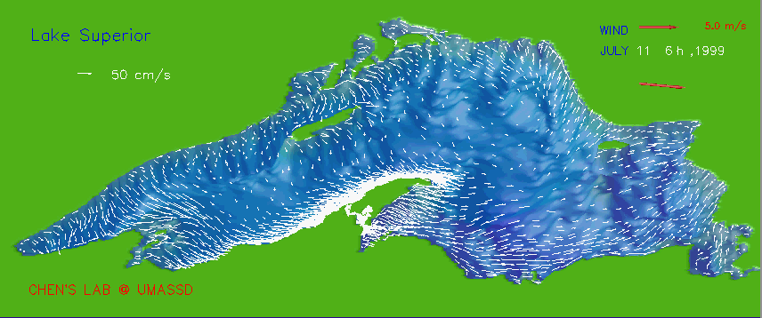
Structured (POM)
Unstructured (FVCOM)

Slide 20
Tidal Resonance in A Semi-closed Channel
Consider a 2-D linear, non-rotated initial problem such as
The solution:
where

Slide 21
1. Normal condition
(non-resonance)
2. Near-resonance condition

Slide 22
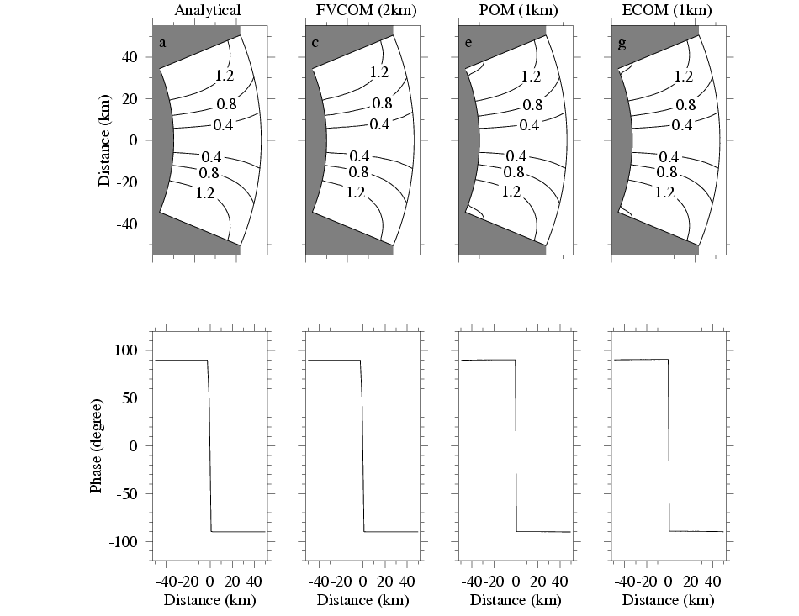
Normal Case

Slide 23
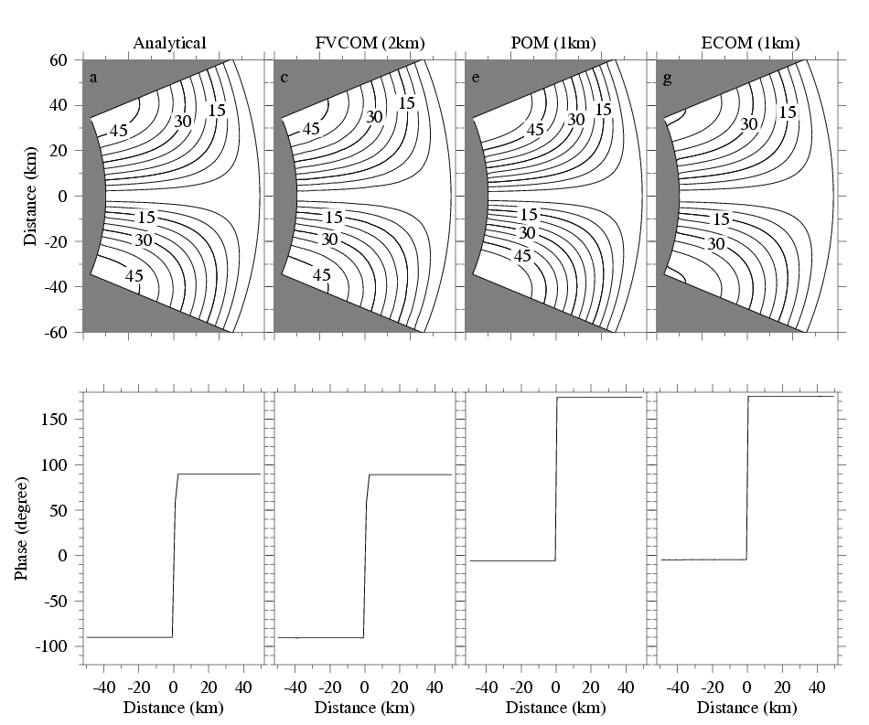
Near-resonance case

Slide 24
Near-resonance, 2 km (FVCOM), 1 km (POM&ECOM-si)

Slide 25
Near-resonance, 2km, Curvilinear

Slide 26
0.5-4 km
4 km
2 km

Slide 27
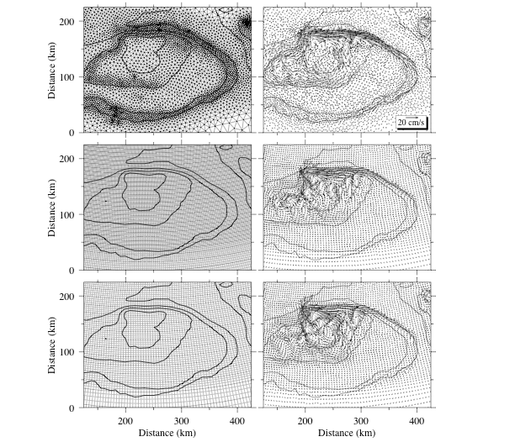
Slope topography
fitting

Slide 28
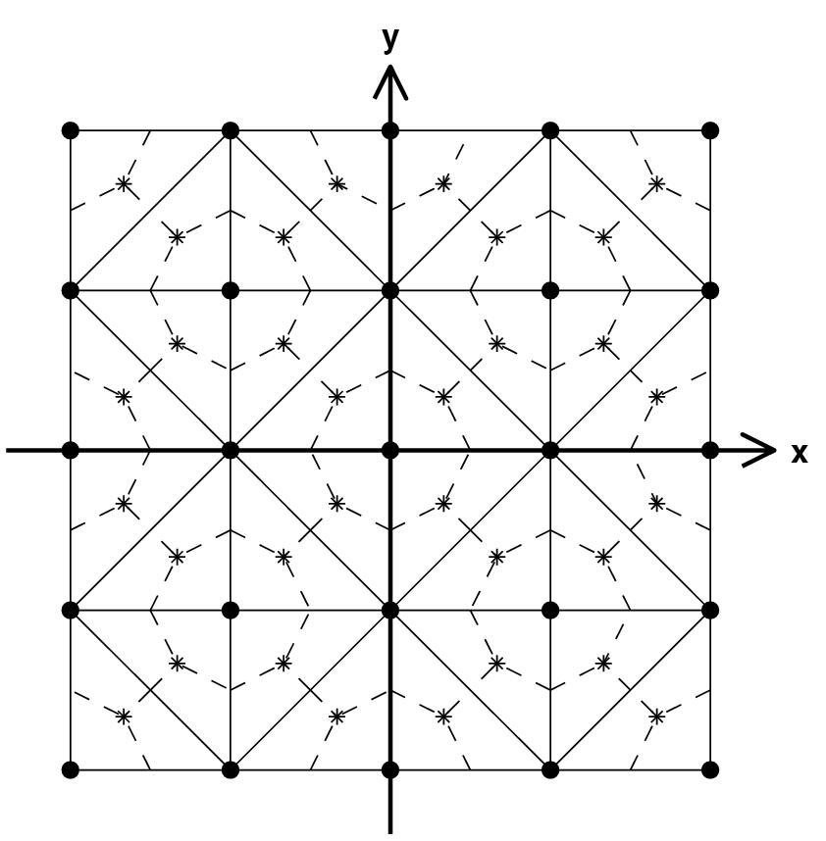
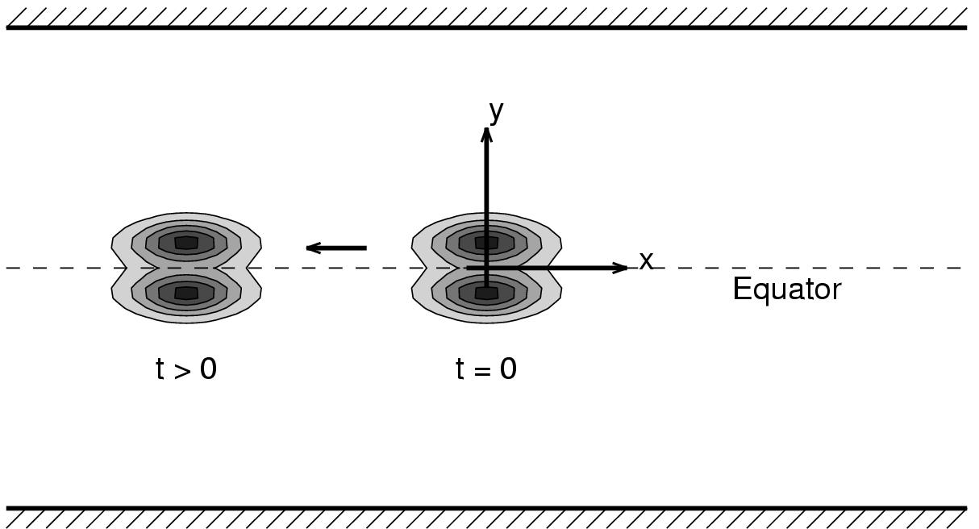
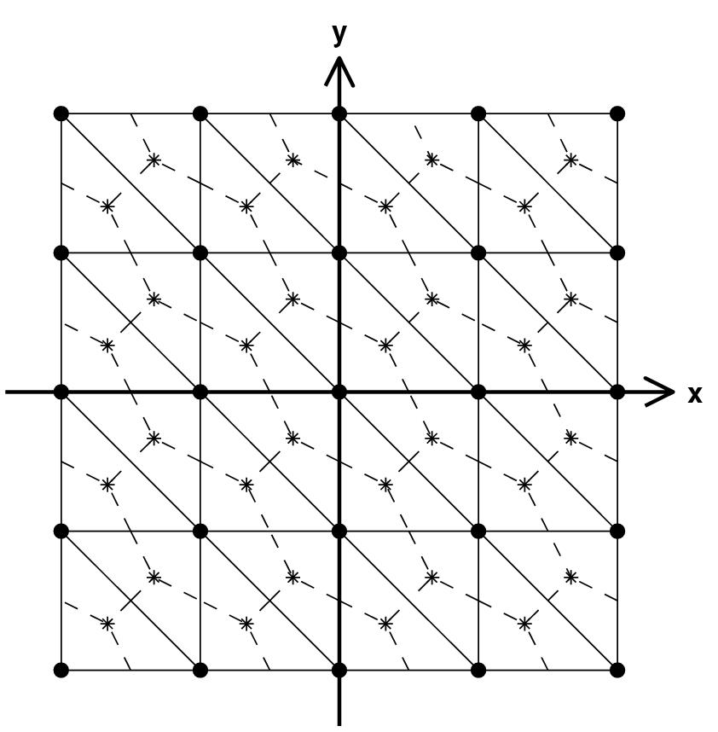
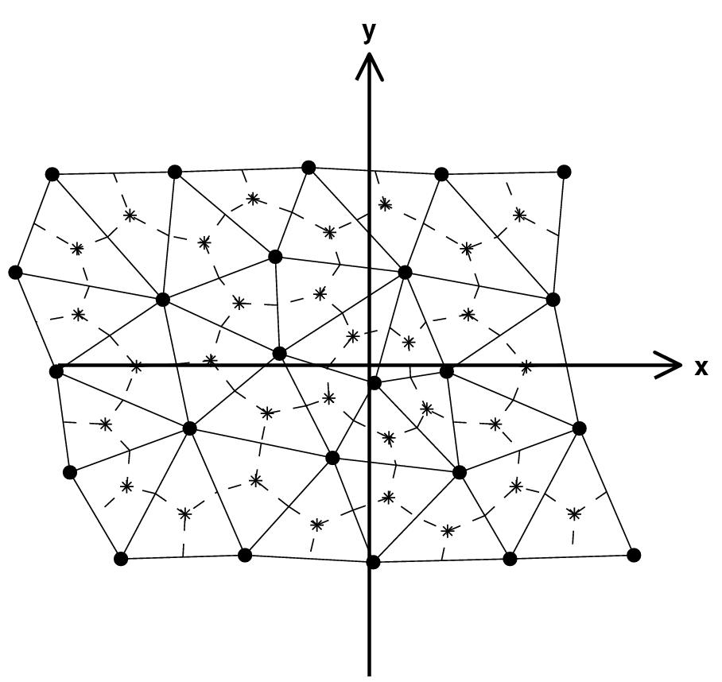
Equatorial Rossby Soliton
L = 48
Grid A
C=0.4
D = 24
Grid B
Periodic boundary condition
Nonlinear shallow water equation in equatorial β-plane
Inviscid flow
Asymptotic solutions available to zero and first orders (Boyd 1980,1985)
Grid C

Slide 29
0.05
0.125
Δx (ND) | FVCOM (2nd) |  | ROMS (4th) |  | SEOM (7-9th)
 | h_{n}/h_{t} | C_{n}/C_{t} | h_{n}/h_{t} | C_{n}/C_{t} | h_{n}/h_{t} | C_{n}/C_{t}
0.5 | 0.472 | 0.917 | 0.884 | 1.088 | 0.923 | 0.98
0.25 | 0.846 | 0.984 | 0.926 | 0.993 | 0.929 | 0.99
0.125 | 0.92 | 0.984 | 0.923 | 0.986 | 0.937 | 0.989
0.05 | 0.935 | 0.983 | 0.936 | 0.983 | 0.915 | 0.98
0.25
Grid A
0.5
h_{n}: Computed peak of the sea surface elevation at 120 units
h_{t}: Analytical peak of the sea surface elevation at 120 units
C_{n}: Computed average speed
C_{t}: Analytical averaged speed.
Grid B
Comments:
Analytical solution only represents the zero and 1st modes, while the numerical solution contains a complete set of higher order modes. This is not surprised to see numerical models can not exactly reach the analytical solutions.
FVCOM shows a fast convergence with increase of horizontal resolution.
Grid C

Slide 31
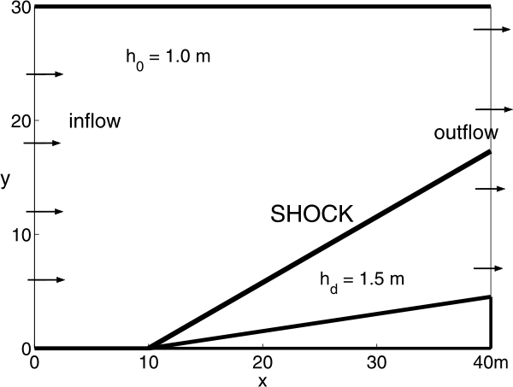
Hydraulic Jump
No gradient condition
Analytical solution:
Maximum sea level:
Minimum sea level:
Mean sea level:
Mean velocity:
Mean Froude #:
Shock angle:
Thickness:
Mean deviation:
(m)
30º
φ = 8.95º
(m)
Characteristics:
Barotropic shallow water equations
No rotation considered, i.e. f =0, β = 0
Steady analytical solutions for u, ζ and the jump angle relative to the x axis.

Slide 32
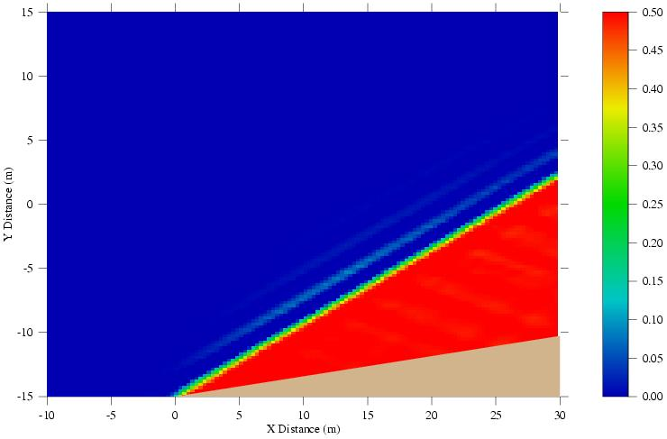
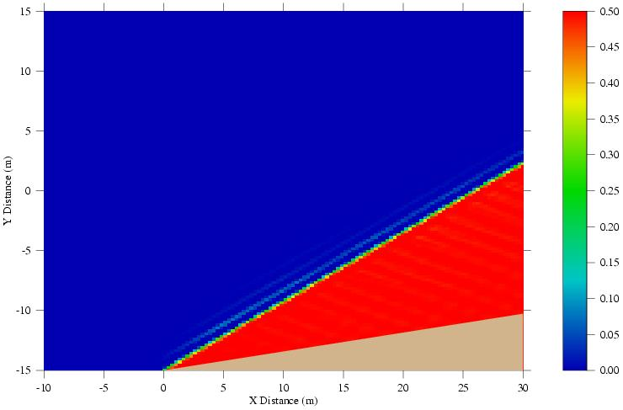
The case with no horizontal diffusion: FVCOM quickly reaches steady status.
∆x = 0.5 m, ∆t = 0.002
∆x = 0.25 m, ∆t = 0.001
∆x = 0.125 m, ∆t = 0.0005
Model | grids | ∆t | ζ_{max} | ζ_{min} | ζ_{mean} | ū | F_{r} | α | δ | |dy|
True |  |  | 0.5 | 0 | 0.5 | 7.956 | 2.075 | 30 | 0 | 0
FVCOM | 80 X 60 | 0.002 | 0.688 | -0.269 | 0.5 | 7.949 | 2.072 | 29.952 | 0.111 | 0.305
 | 160 X 120 | 0.001 | 0.697 | -0.268 | 0.499 | 7.951 | 2.073 | 30.030 | 0.063 | 0.151
 | 320 X240 | 0.0005 | 0.696 | -0.272 | 0.5 | 7.951 | 2.073 | 30.029 | 0.037 | 0.076
ROMs | Reach an oscillatory solution without horizontal diffusion.

Slide 33
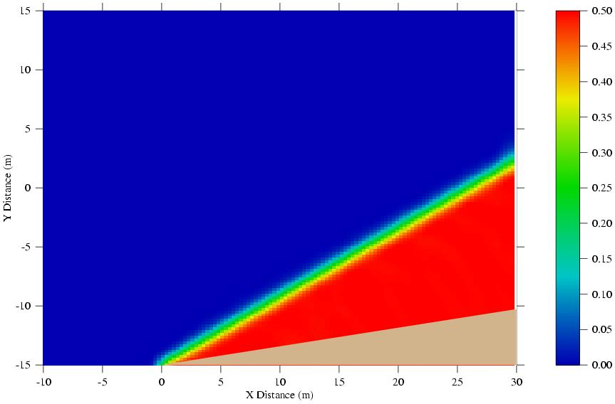
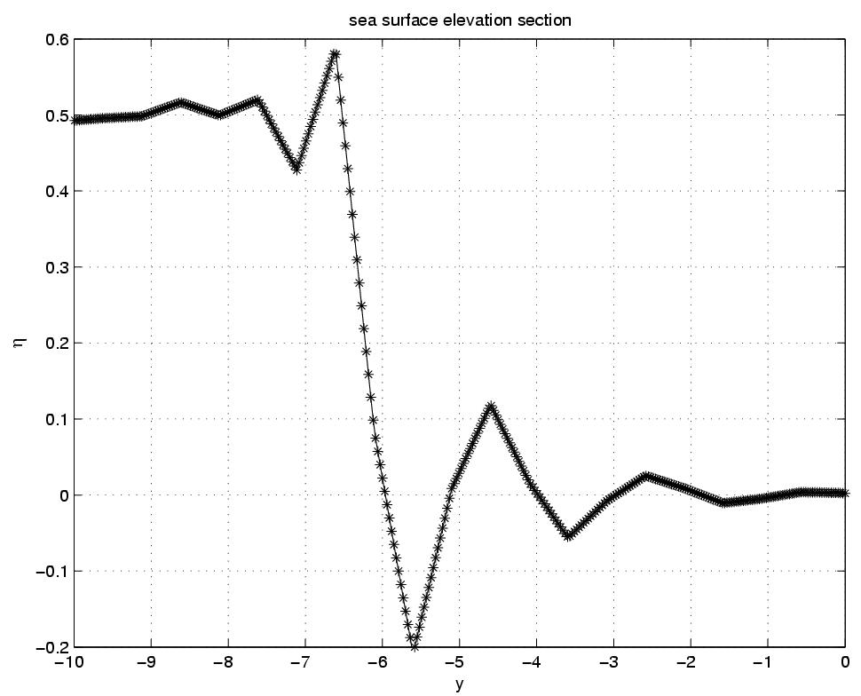
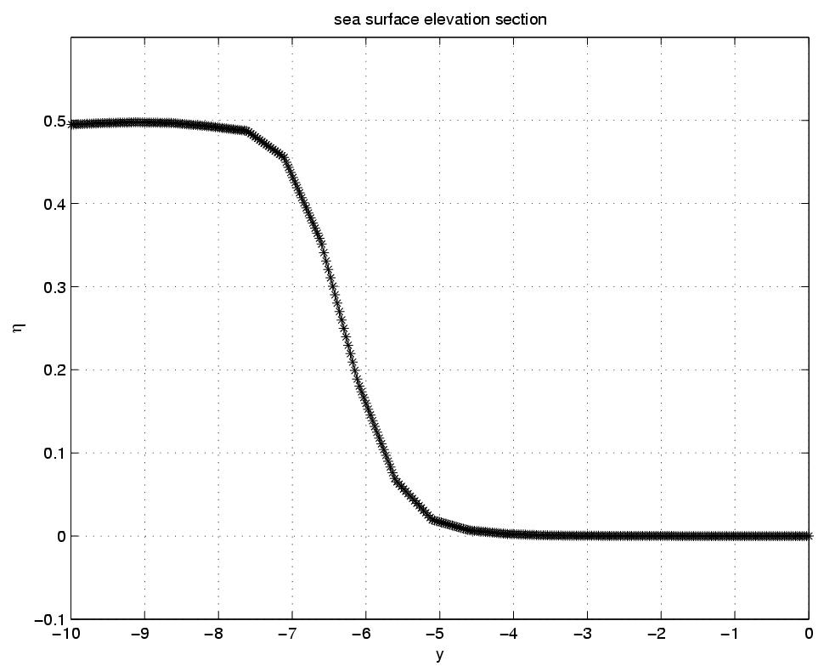
Over shocking can be reduced by introducing a slope limiter method (Hubbard, J. Comput. Phys., 1999).
Original code
Modified code with limiter

Slide 34
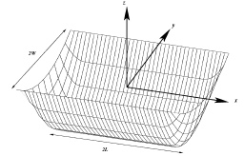
3-Dimensional Wind-Driven Flow in an Elongated, Rotating Basin
Winant (J. Phys. Oceano. 2004)
z
y
Governing equations:
2B
x
B.Cs:
2L
Length: 2L; width: 2B, and bathymetry:
Steady status analytical solution for this linear equation system is given as:
where X(x) is a function in the form of
∆x is a constant specified as 0.3% of the total length of the basin.
where α² = 2iδ⁻² and δ = (2E)^{1/2} (E: Ekman number).

Slide 35
Analytic
FVCOM

Slide 36
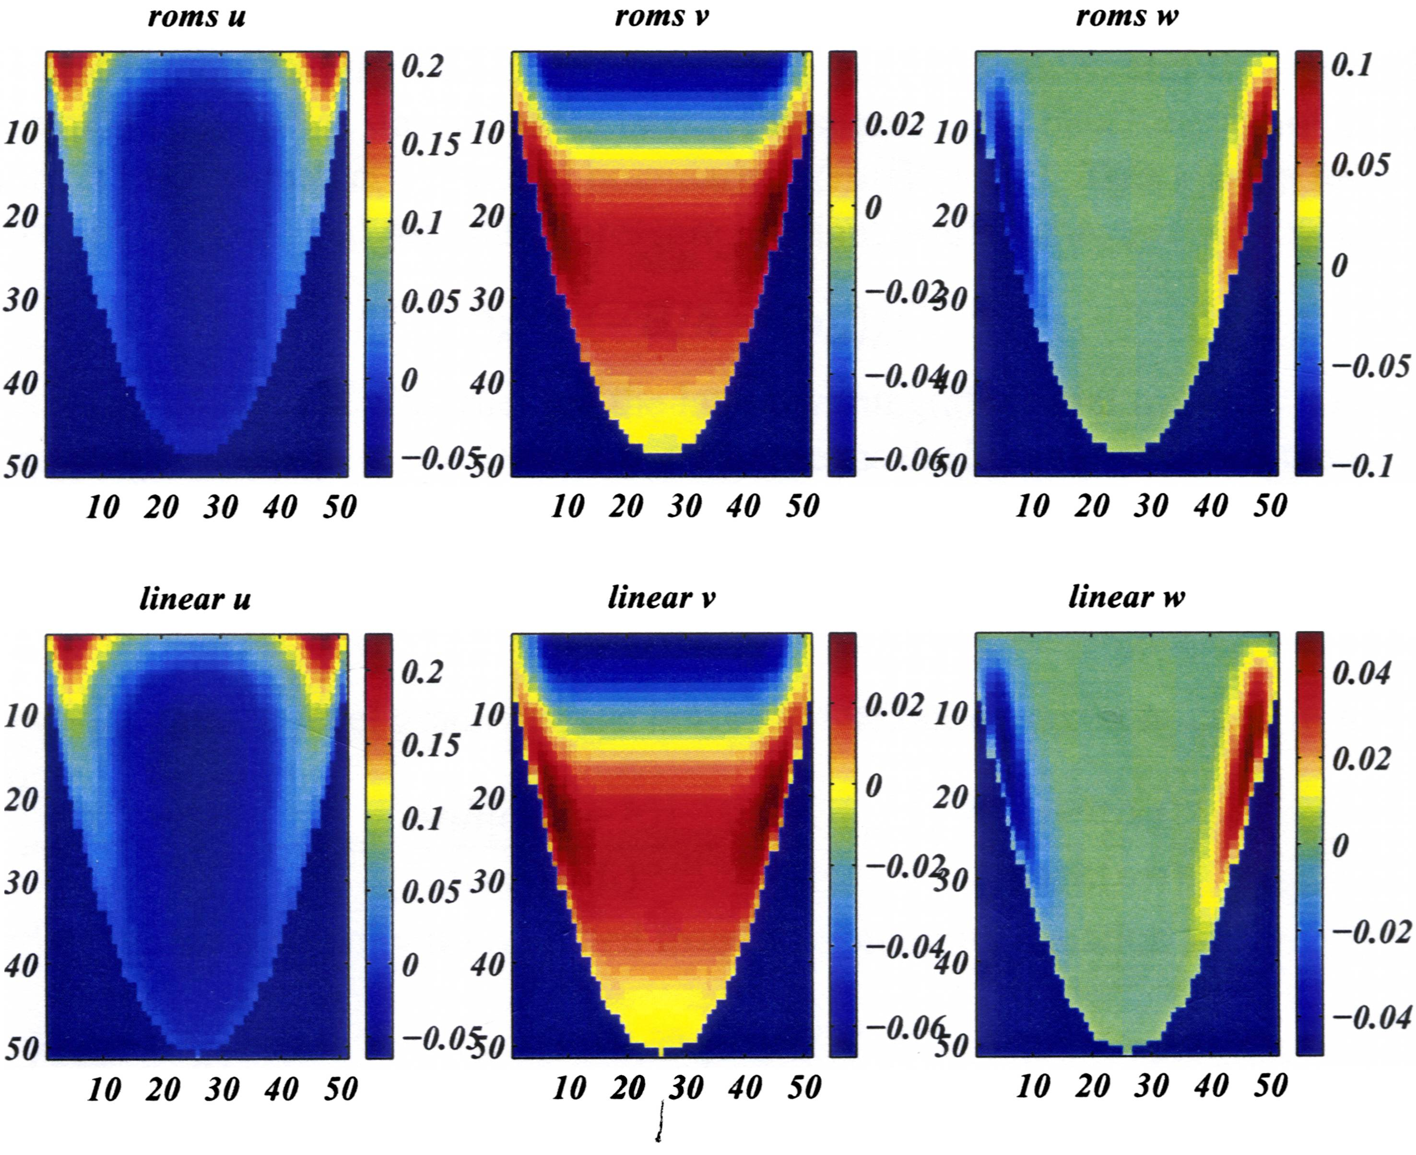
ROMs
U
V
W
Analytic
Be aware that ROMs underestimates u and overestimates w (color bar scales are different for analytical and ROMs’ solutions). This figure is scanned from Winant’s working note.

