Slide 1
MAR513 Lecture 12: Marine Ecosystem Modeling
Keynotes:
Traditional ecosystem model:
Complex biological structures but simple physics, focus on making the biological system more complex but considering physical processes as a secondary factors than biological processes.
Examples:
1-D biological model.
This type of the model is a good tool to understand the energy transfer between trophic levels under given control parameters, but can not use to understand the complex ecosystem in the realistic ocean conditions.
QS: Does it make sense to develop a complex ecosystem model?

Slide 2
1. Uncertainty
y
A straight line can be determined by the linear function with two constant parameters a and b. This system is controlled by two degrees of freedom, which means that if a and b are determined, the function is fixed. Or, if you know the value of y at two points in the x axis, you can determine this function.
x
A curvature line can be fitted using a polynomial function. A better fit always can be reached by including more higher order terms. However, adding more terms increases the degrees of freedom, and thus reduce the confidence level!
x

Slide 3
1. Stability
b
a
Linear
a+b
Add a perturbation
b
a
Non-linear
Add a perturbation

Slide 4
The energy transfers among the trophic levels are characterized by nonlinear processes;
The biological processes such as uptake and grazing, etc, are parameterized with empirical functions;
Biological parameters are in a wide range of the uncertainty and also varies with space and time;
A simple NPZ model includes 7 biological parameters;
A two species NPZD model might includes more than 30 or 40 parameters;
Since biological parameter varies in a big range, one could easily tune the parameters to make the model to fit the data. Unless most sensitive parameters can be accurately measured, tuning the model to fit the model just like using the high-order polynomial to fit the curvature line! This is a typical example what we call “false” science!

Slide 5
To be a good ecosystem modeler,
first you should be an honest person!

Slide 6
What procedures do one need to follow to build an ecosystem model?
Clear objectives;
Determine the model structure (variables and forcings) to meet the minimum request to achieve your objective;
Select the empirical functions that are suitable for the local ecosystem;
Determine the biological parameters
Test the stability of the model system and sensitivities of the model to the uncertainty of biological parameters.

Slide 7
Basic Concepts
1. Steady State
B
A
Solution:
Assume that the concentration in V is zero at initial, we have
as t→∞
This state is called “steady state”.
QS: Does this system depend on the initial concentration in V?

Slide 8
2. Stability
In the above example, we show that no matter what the initial concentration in V is, the concentration will eventually reach C_{I}. If we treat the initial concentration in V as a perturbation (for example, V is filled with a pure water at initial), when the water with a concentration of C_{I} flow into V from section A at a speed of U, this inflow water will mix with the pure water and flow out of V from section B. Eventually, the concentration in V reaches a steady state (C_{I}). Therefore, we say that this system is stable.
In general,
When external or internal perturbation occurs, an ecosystem might changes. If this system quickly come back to its initial equilibrium state after the perturbation stops, then we call this ecosystem stable. Otherwise, it is an unstable system.

Slide 9
Two types of the stability:
Local stability: If an ecosystem can come back to the equilibrium states before the perturbation, we call this system “local stable system”;
Global stability: no matter what the initial condition is, the ecosystem always can reach an equilibrium state (or steady state), this system is called “global stable system”.
If an ecosystem is local stable, it is generally global stable.
In the ocean, the ecosystem is generally characterized with a strong nonlinearity. Some ecosystem model system might not be able to return back to the equilibrium state after perturbation. If an ecosystem model is not stable, then this ecosystem will not have a finite solution. Such a system meaningless for the ecosystem dynamics.

Slide 10
3. Resilience
The resilience is defined as the rate at which the ecosystem returns back to its initial equilibrium state after the perturbation. This rate is an indicator of the relative stability of an ecosystem.
In our example, the e-folding time scale for the system to return to the steady state is
This time scale is generally called resilience time scale, so the resilience for this system is equal to

Slide 11
The resilience time scale usually can be determined by integrating the normal resilience rate with respect to the time. For example,
In V, C is the concentration at a time of t, C_{I} is the concentration at the steady state, and their difference is C-C_{I}. This difference has its maximum at initial, i.e.
C*-C_{I}
and decreases exponentially with time. Then the resilience time scale can be defined as
Then,

Slide 12
For an estaurine case, we can divided the estuary into segments. For example,
………….
n
1
2
3
C_{i} is the concentration in segment I, then we have
C_{o,i} and C_{I,i} are the initial pertubation and steady state concentration values in segment i.

Slide 13
4. Residence Time
Assume that C is the concentration in V, and then the total concentration in V equals to CV. Assume that U is the inflow velocity, the flux inflow into V is CU. For this condition, the residence time is defined as
In this case, the residence time is equal to the resilience time
Assume that Co is the initial concentration in V, the pure water is flow into V at a speed of U, then the residence time can be defined as the flushing time as
Here, T=V/U is the flushing time, which is the same as the residence time

Slide 14
Definitions of “Flushing” or “Residence Time”
1: Fraction of freshwater method:
V_{f}: The volume of freshwater in an estuary
R: River discharge
Bowden (1967); Dyer (1973); Fisher et al. (1979)
Alber and Shelden (1999)
2. Tidal prism method:
V_{Low}: The volume of the water of an estuary at low tide;
P: Tidal prism
Bowden (1967); Dyer (1973)
3. Modified tidal prism method:
Sanford et al. (1992)
4. Dynamical tracer method:
The average time the initially existing water parcels reside in the system before they are flushed out
t is the time;
M(t) is the total mass of the tracer remains in an estuary
Wang et al. (2004)

Slide 15
5. Resistance
Resistance in the ecosystem dynamics refers to the relative change of a variable due to flowing in or flowing out of the biological flux in a system. This usually is used to estimate the sensitivity of an ecosystem relative to the change of the inflow or outflow, biological parameters, and other factors.
Assume that F is one of the biological variables, a is the parameter related to F, then the sensitivity of F with respect to a can be estimated by
In general, if is larger than 0.5, we treat this parameter as a sensitive parameter. The experiments are usually made by changing a by 1% to see if
would be larger than 0.5 after F changes.

Slide 16
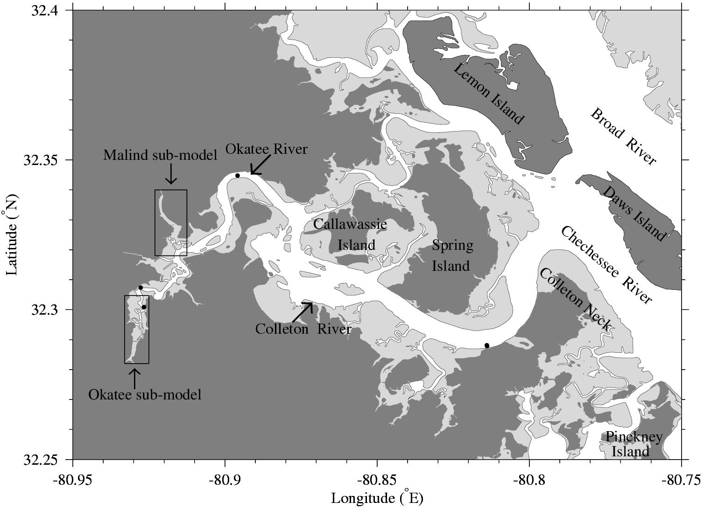
Study Area

Slide 17
Chen’s Lab at UMASSD

Slide 18
Surface Residual Flow

Slide 23
Numerical Model Mesh and Bottom Bathymetry
Open boundary
Digital Elevation Map
Freshwater discharge

Slide 24
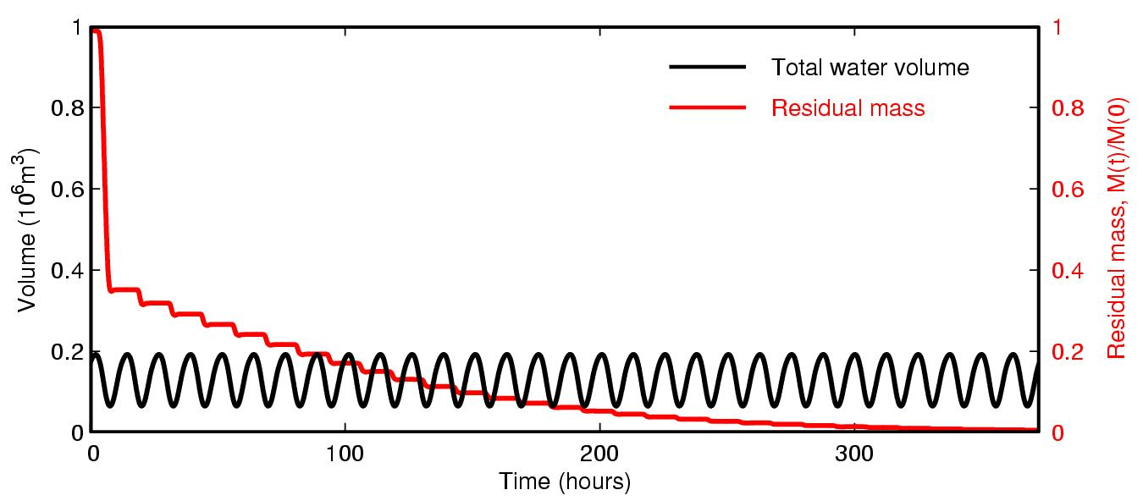
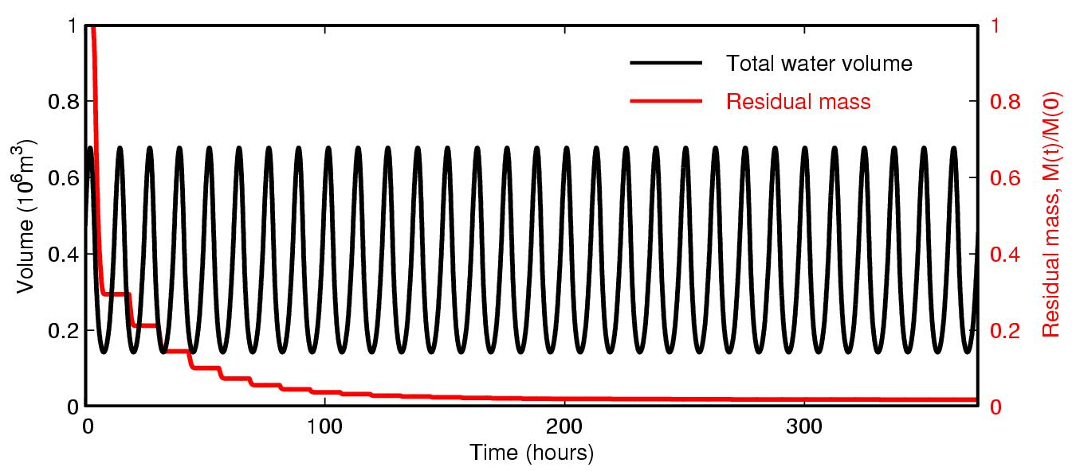
Scenario 1 : Without inter-tidal salt marshes
T_{r} = 47.5 hrs
= 2.0 days
Scenario 2 : With inter-tidal salt marshes
T_{r} = 16.4 hrs
= 0.7 days

Slide 25
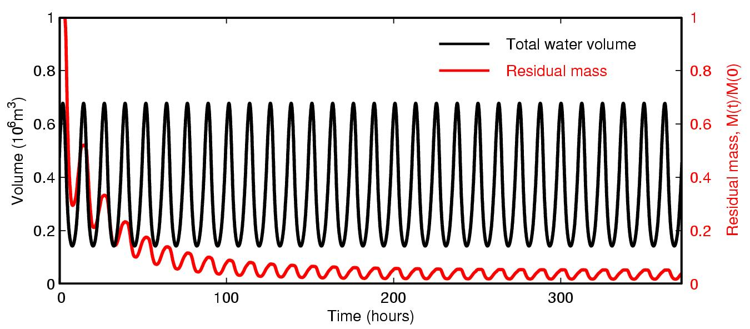
Scenario 1 : Without inter-tidal salt marshes
T_{r} = 47.5 hrs
= 2.0 days
Scenario 2 : With inter-tidal salt marshes
T_{r} = 16.4 hrs
= 0.7 days

Slide 26
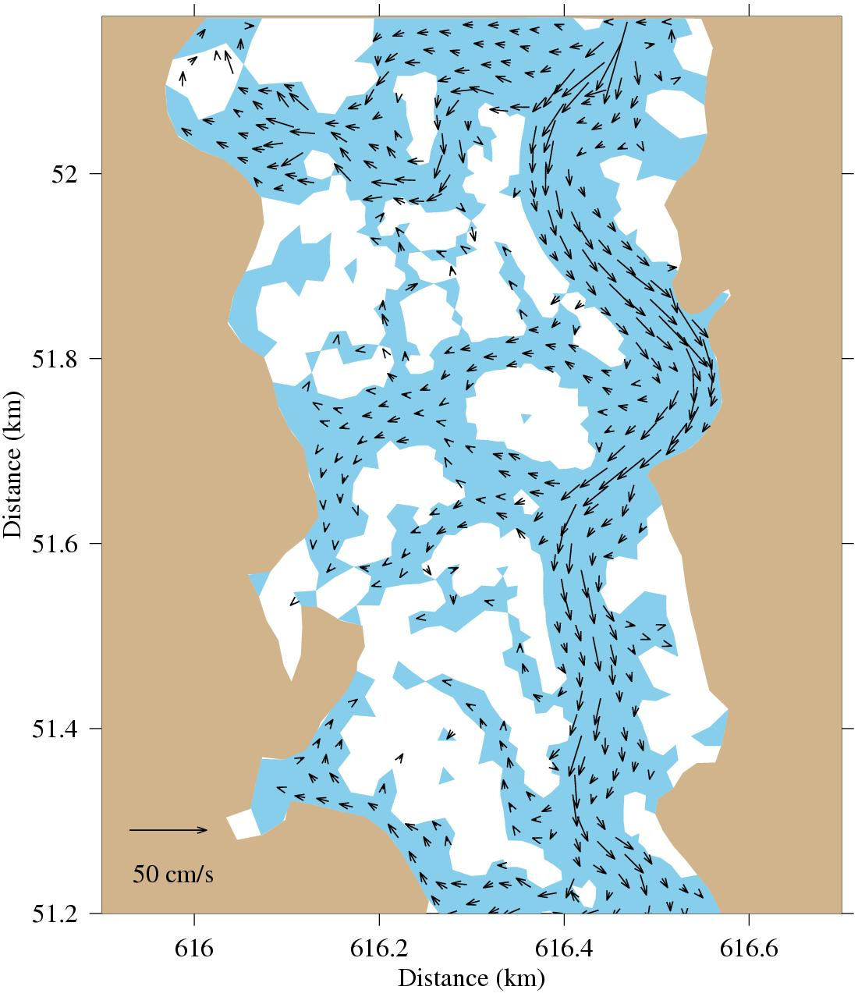
The spatial distributions of the maximum flood tidal Currents

Slide 27
A Simple N-P Model
N: Nutrients; P: Phytoplankton
N
Input
Output
N_{f}
P ?
Uptake
Mortality
P
(Michaelis-Menten)
The nutrient outflow rate
Phytoplankton loss due to outflux
Flux out from the system

Slide 28
The N-P governing equations:
1) Conservation
or P+N = Constant
Without inflow and outflow, the N-P system is conservative

Slide 29
2) Steady state solution
At the steady state, the nutrient concentration in the system does not depend on the nutrient inflow.
For given biological parameters, the phytoplankton biomass is linearly proportional to the nutrient concentration
When the inflow nutrient is equal to the outflow nutrient, the phytoplankton biomass equals zero.
When

Slide 30
P
dP
=
0
dN
=
0
dt
dt
*
0
K
N
ε
P
N
K
N
(
ε
P
+
γ
P
)
γ
N
N
S
f
(
I
)
V
m
−
ε
P
f
(
I
)
V
m
−
ε
P
−
γ
P

Slide 31
If
or
or

Slide 32
Local stability
Examine if the system could go back to the equilibrium state after perturbation.
Rewrite N and P as
Substituting them into the N-P equations, we have
Because

Slide 33
we can get a perturbation equation as
This is a homogenous differential equation, and the property of its solution is determined by the eigenvalues of the matrix given as
Define that

Slide 34
we have
The solution is
This means that the perturbation of N and P will decay with time. This system is stable.
For a general case
The solution will be negative real value. The system is stable.
The solution will be a complex function. Since the real part of this function is
negative, so that the solution is stable.

