Slide 1
MAR513 Lecture 11: Surface Wave Modeling
z
y
Conditions:
a) no rotation; b) incompressible; c) linear
Air
x
0
-H
Sea
The perturbation momentum and continuity equations can be written as
Boundary condition:
At the bottom:
At the free surface:

Slide 2
Laplace’s equation
Assume that the solution is
Therefore,
This is impossible!

Slide 3
Instead, we will try
then,
Assume that the solution is
where
At the bottom,

Slide 4
So, the solution can be written as
At the surface,
Therefore,

Slide 5
Also,
Find the frequency ω. Assume that
At the free surface,

Slide 6
The solution of the surface gravity wave:
Phase speed: Assume that the total wave number

Slide 7
y
x’
They differ from the x and y component of v_{p}
v_{py}
v_{px}
x
The rule for the vector calculation is not applicable to determine the x and y components of phase speed.

Slide 8
Short-wave approximation
k_{o}H>> 1, H >> 1/k_{o}~L: Deep-water waves
In this approximation, tanh (k_{o}H) ≈ 1,
The phase speed equals

Slide 10
The real parts of the solution are given as
The short-surface waves are trapped near the surface over a e-folding vertical scale of 1/k. Therefore, the propagation of waves is not affected by the bottom
Particle trajectories

Slide 11
Particle trajectory in a deep-water wave is a circle and its radius decreases with depth.
The size of circle ~ A; k/ω; z;
The phase of waves propagates, but particles don’t;
Average over a wave period, the velocity equals zero;
The phase speed is a function of the wave number but does not depends on the water depth;
The waves are trapped near the surface. In this deep-water, the hydrostatic balance is not valid.
Orbits are circular

Slide 12
Long-wave approximation
k_{o}H << 1, H << 1/k_{o}~L: Shallow-water waves
In this approximation, tanh (k_{o}H) ≈ k_{o}H-1/3(k_{o}H)^{3…..} ≈ k_{o}H

Slide 13
Particle trajectories
The particle’s trajectory is an ellipse
The pressure and horizontal velocity are independent of depth, while the vertical velocity is a linear function of depth;
The phase speed is determined by total water depth, but independent of the wave number;
In the shallow water limit, the hydrostatic balance is valid

Slide 14
Stoke’s drift velocity
The conclusion for the particle trajectories of the deep-water waves is only valid for a linear model. The linear theory describes the wave motion of “sinusoidal” function in the propagation direction. In the field of waves, the average velocity of particle equals to zero. However, it is not true for finite-amplitude gravity waves in a nonlinear system. In such a system, the particle orbits are not closed and there is a slow mean drift of the fluid elements in the direction of wave propagation: stokes’ drift!
Suppose in an oscillated motion, the fluid element still keep its position near the initial location

Slide 15
Stokes’ drift velocity
In the zero-order approximation,
In the first-order approximation,

Slide 16
The Surface Wave Model (SWAN or FVCOM-SWAVE)
(references: Booij et al. 1999, SWAN Team, 2006, Qi et al. 20008)
The evolution of wave spectra is determined by the wave action density spectrum balance equation expressed as
where N is the wave action density spectrum; t is the time; σ is the relative frequency; θ is the wave direction.
Two spaces: the spectral space (σ, θ) and in geographic space (x, y)
where S_{in} is the function for the wind-induced wave growth; S_{nl3} is the nonlinear transfer of wave energy due to three-wave interactions; S_{nl4} is the nonlinear transfer of wave energy due to four-wave interactions; S_{ds,w} is the wave decay due to white capping; S_{ds,b} is the wave decay due to bottom friction; and S_{ds,br} is the wave decay due to depth-induced wave breaking.

Slide 17
Discrete Algorithms:
SWAN (Simulating Waves Nearshore): The structured grid (rectangular or curvilinear) and is solved by implicit schemes in both spectral and geographic spaces (SWAN Team, 2006);
FVCOM-SWAVE: The unstructured grid (triangular) and is solved by the Flux-Corrected Transport (FCT) algorithm in frequency space; the implicit Crank-Nicolson method in directional space and options of explicit or implicit second-order upwind finite-volume schemes in geographic space (Qi et al., 2008). FVCOM-SWAVE is the unstructured grid of SWAN at the second-order accuracy.
UnSWAN: A new unstructured grid version of SWAN developed by the SWAN Team. At present, it is solved using the first-order accurate discrete scheme.
FE-WAVE: A unstructured grid version of SWAN solved using the finite-element method (Hsu et a., 2005). This is not an open-source code.

Slide 18
Test 1: Dispersion experiments
SWAN-BSBT (1st order)
SWAN-SORDUP (2nd order)
stationary wave only
Hs (Significant wave height) = 1 m
σ (frequency) = 0.1 Hz
SWAN-SL (3rd order)
UG-SWAN (2nd order)
Upwind
Examine the numerical dispersion for the wave propagation

Slide 19
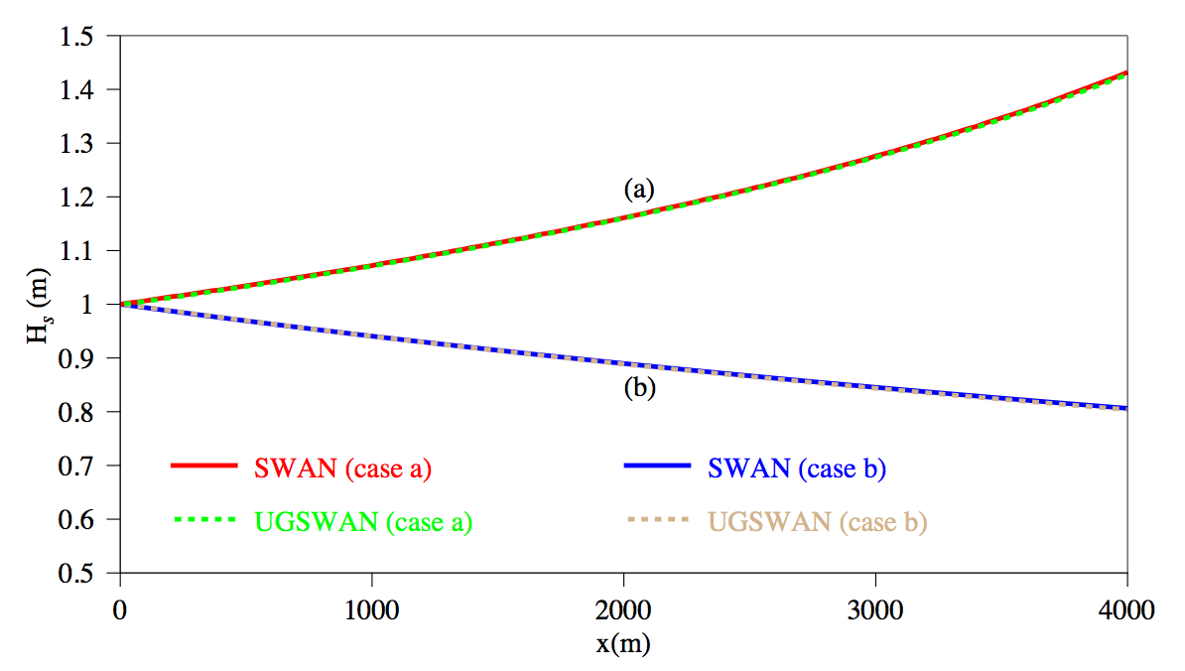
Test 2-a: Wave and Current Interaction
Case a:
Results for significant wave height
C_{g}
Case b:
C_{g}

Slide 20
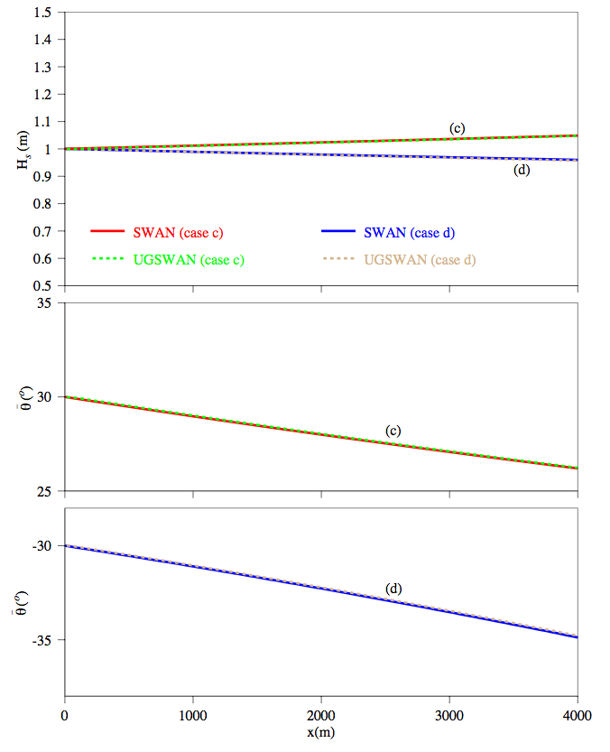
Test 2-b: Wave and Current Interaction
Results for significant wave height
Case c:
30º
C_{g}
Direction
Case d:
C_{g}
Direction
30º

Slide 21
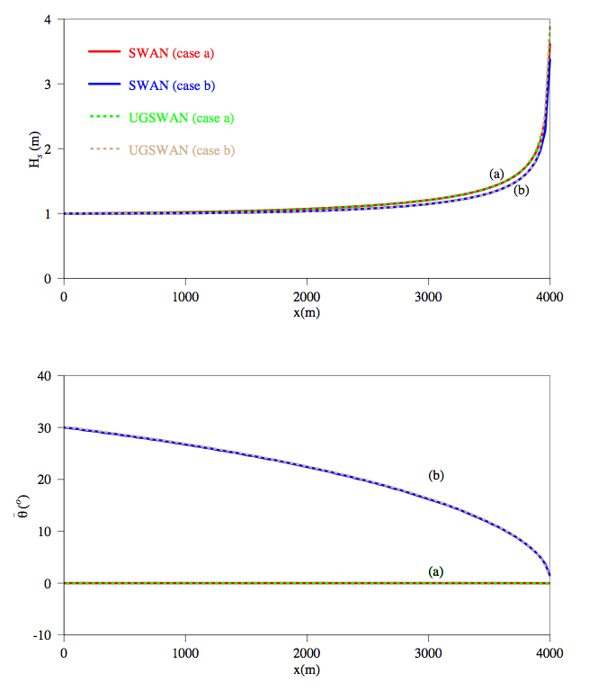
Test 3: Wave propagating onto the shelf
Case a:
C_{g}
Case b:
C_{g}

Slide 22
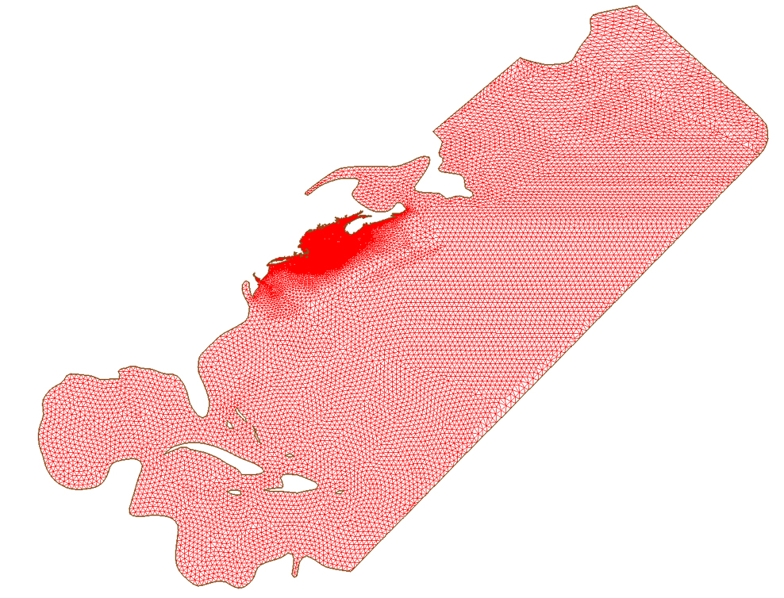
A Test Case for the Gulf of Maine

Slide 23
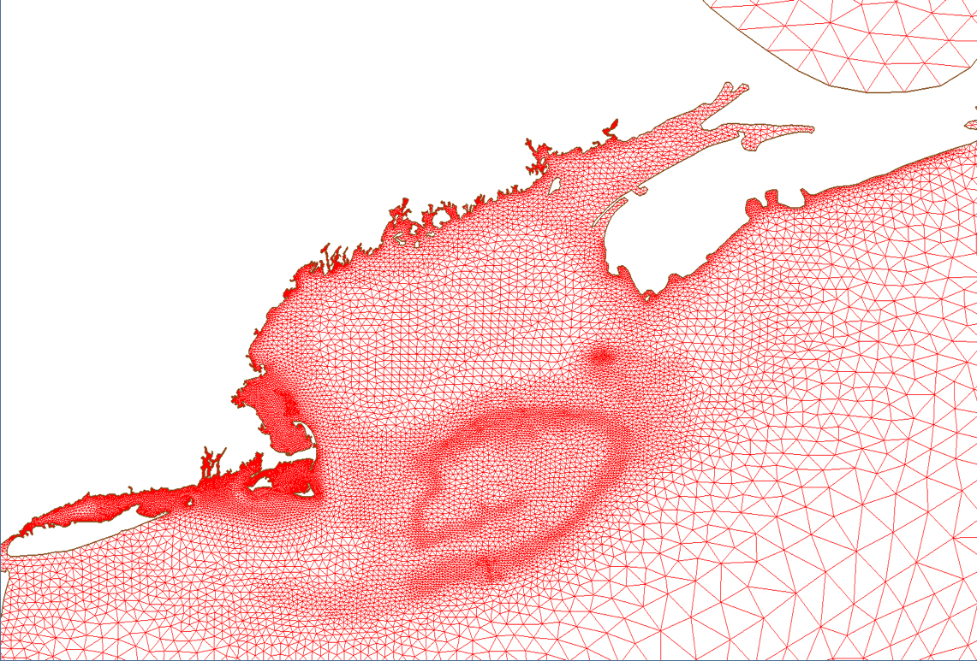
A zoom-in view of the Gulf of Maine domain

Slide 24
Forcing:
GOM-WRF hindcast wind fields (with a resolution of 9 km) [one component of the Northeast Coastal Ocean Forecast System (NECOFS] plus 32-km Atlantic Oceanic WRF produced wind fields;
Wave growth function by wind: 1) Komen et al. (1984), 2) Janssen (1989, 1991) and 3) Yan (1987);
Whitecapping function: Komen default formula;
Period: January 1 2007 to January 30, 2007
Time step: 1.5 minutes
32 CPU: one computational days for 10 real days

Slide 25
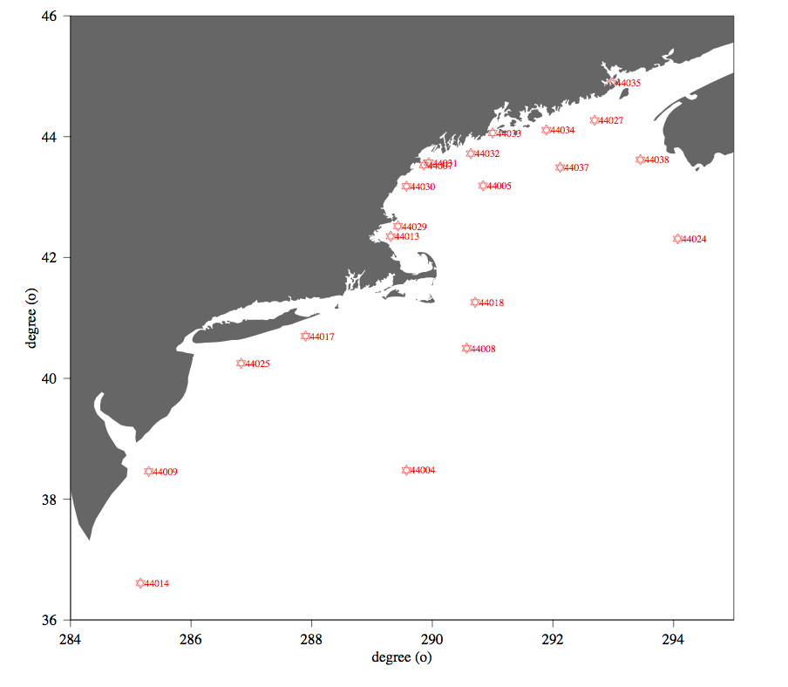

Slide 26
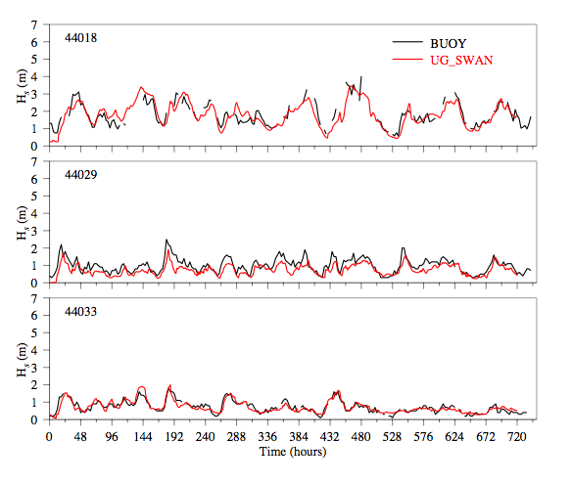
Komen growth function

Slide 28
Coupling of Hydrodynamics and Wave Models
The coupling of hydrodynamics (motions with a period longer than the surface waves) and waves is by the radiation stresses:
where
S_{xx}, S_{xy}, S_{xz} are the x, y and z component of the radiation stress in the u-momentum equation;
S_{yx}, S_{yy}, S_{yz} are the x, y and z component of the radiation stress in the v-momentum equation.
Reference: Warner et al. (2008).

Slide 29
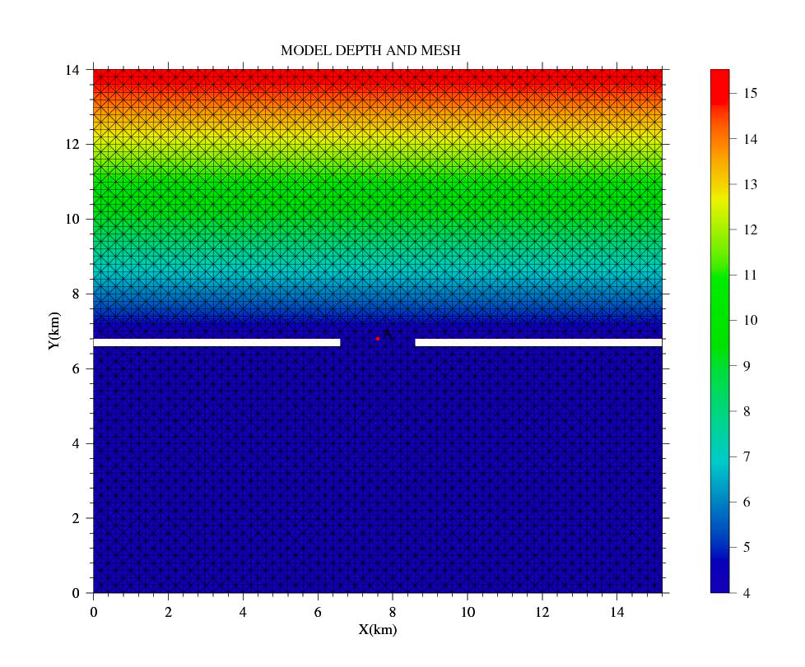
The benchmark test for the coupled hydrodynamics-wave code
Experiments made by Wu

Slide 30
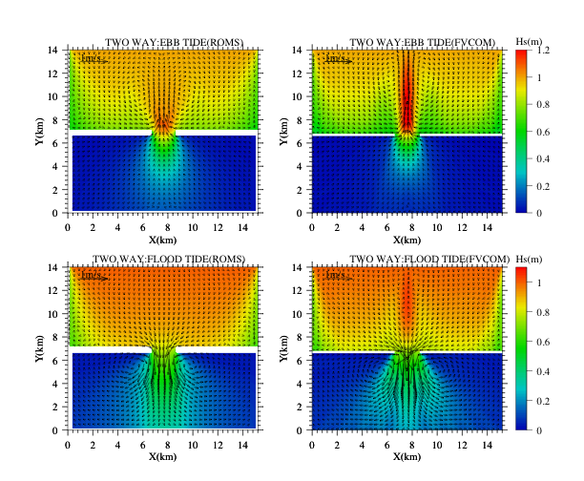

Slide 31
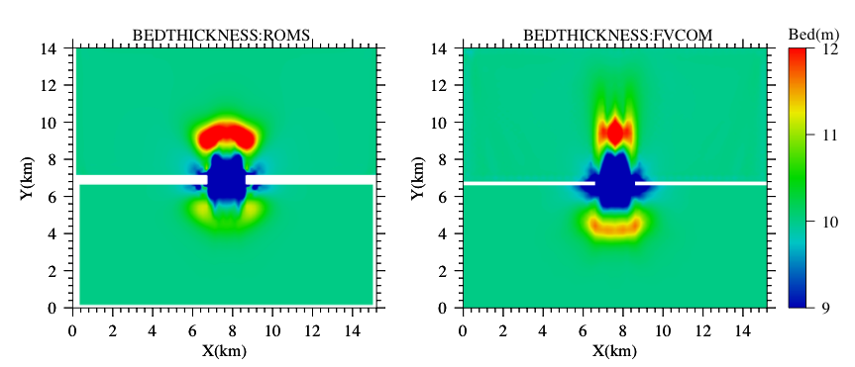
Bed thickness comparison

