Slide 1
MAR513 Lecture 10: Pressure Errors in Terrain-Following Coordinates
The vertical coordinates:
The z-coordinate
The Terrain-following coordinate
Advantage: Simple
Disadvantage: Poorly resolve topography
Advantage: Accurately resolve topography
Disadvantage: Pressure errors

Slide 2
The hybrid coordinate
σ-coordinate
H_{f}
s-coordinate
Watershed, inter-tidal zone with the mean water depth of ≤ 0
Surface mixing layer and bottom boundary layer
Precipitation via evaporation
SST assimilation

Slide 3
Pressure error in the σ-coordinate
An example based on the σ-coordinate:
z
y
ζ
After the transformation, the vertical domain will have a range of (0, -1)
x
0
H
In the hydrostatic balance,
Integrating from z to ζ

Slide 4
In the σ-coordinate
Let us only consider the pressure in the water, we have
The final form of the pressure gradient can be written as
Where and ρ_{s} is the reference density.

Slide 5
Note:
After the σ-transformation, the pressure gradient term consists of two terms with opposite signs. This means that the pressure gradient in the σ-transformation coordinate system always equals to the difference of two terms.
The two terms are in the same order of magnitude and the difference is a small value resulted from the difference of two big values.
This means that a small numerical error in these two big value terms could cause a big error in the numerical calculation of pressure gradient ! !
For example, A = B -C. Given B = 100 and C = 99, then A = 1
Now, let us add ~1% error in B and C,
B = 101, C= 98, then A = 101-98 = 3
In this case, the resulting error for A is
(3-1)/1 = 2 ⇒ 200%

Slide 6
The error velocity likes the geostrophic motion: largest at the steepest topography. Since it is the same direction as the geostrophic current, it is difficult to distinguish it in the shelf break area where the shelf-break front is located.

Slide 7
QS: Could we develop a numerical scheme to avoid the numerical error in the pressure gradient calculation?
We might be able to design a scheme to reduce this error but it is difficult to have a method that can guarantee no error.
This issue has been addressed in many popular ocean models (like POM, FVCOM and ROMs) with different approaches.
For example:
Remove the mean density at each level;
Introduce a highly order approximation scheme;
Design the scheme to ensure no error in the vertical-linearly distribution of the density profile,

Slide 8
For example: Chen and Beardsley (1995)
Consider the x-z plane on which x is the cross-isobath direction and z is the vertical direction. Assume that the initial density is a linear function of z,
In this case,
In the inviscid ocean, the σ-transformation will not produce the error motion over steep topography if only the perturbation density relative to the horizontal uniform reference density is used to calculate the pressure gradient. This is because

Slide 9
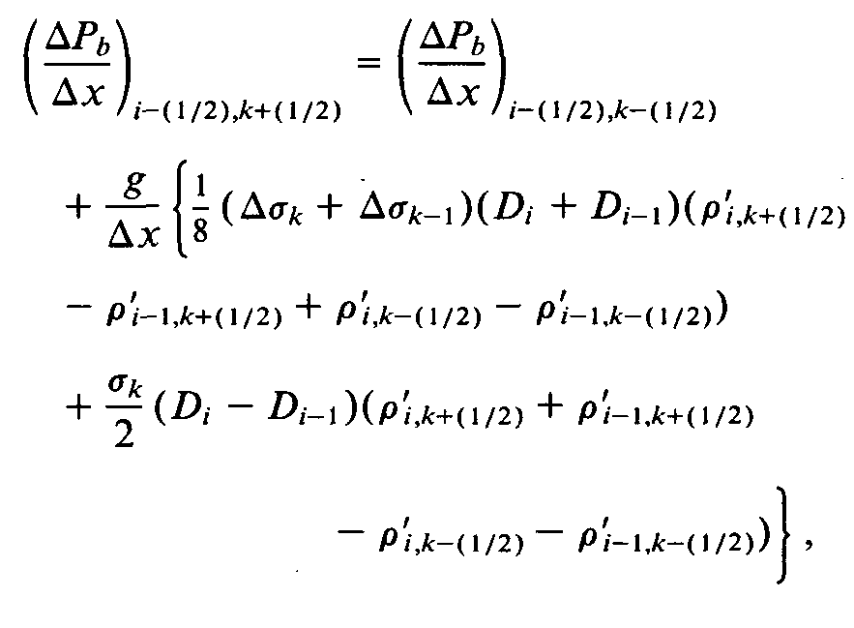
However, once diffusion is included or the system is forced externally, then
For the two-dimensional problem, the perturbation density is a function of x, z and t, and it can be rewritten as
Let us use the numerical scheme as an example for this exercise
k-1
k ={2, KB-1)
k
k+1
KB
σ = -1

Slide 10
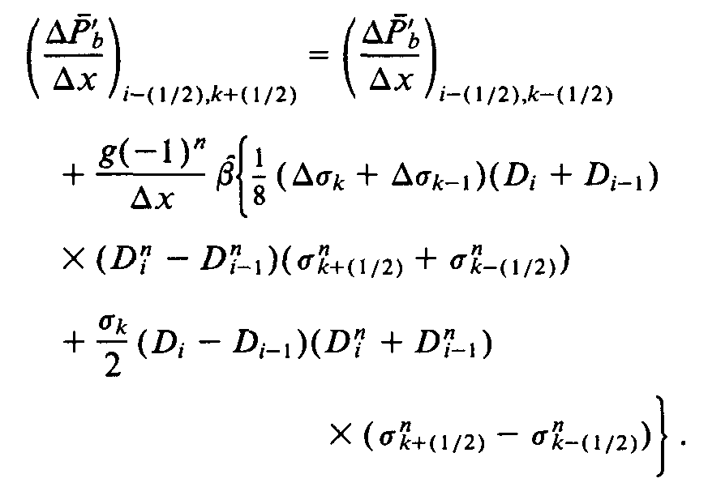
Let us assume that
then, we have
For n = 1
If the uniform σ levels are used,
Δσ = Δσ_{k} = Δσ_{k-1}
If the one could design a scheme to ensure no error in the first layer, then the model produce no error in all the layers.

Slide 11
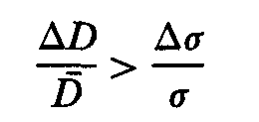
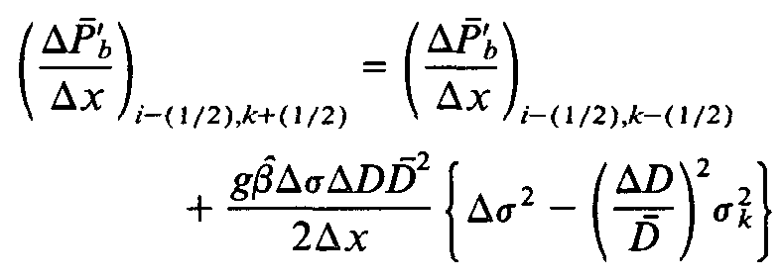
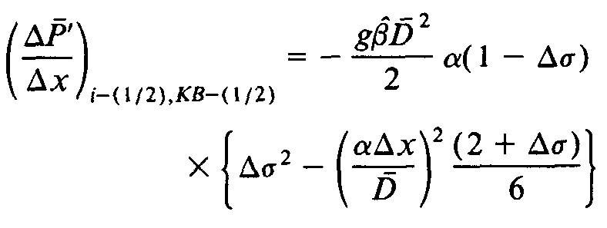
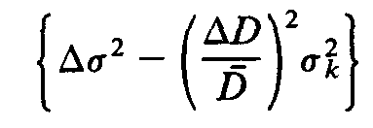
In general,
For n =2
The maximum error is at the bottom. At k= KB-1,
where
The error is proportional to the difference between two terms as follows
Then, the error velocity can be estimated by
The first is independent of k and the second increases downward as k becomes large (k changes from 1 to KB)

Slide 12
In a case with steep topography, for example, α ~0.03 (Georges Bank)
V_{e} ~ 0.2 cm/s
This error is not very big. However, since the system is fully nonlinear, the big error velocity could be produced by the accumulation errors resulted from nonlinear interaction.
In the real ocean, diffusion over the slope tends to mix the water in the vertical, and the condition of no density flux into the slope bottom requires that the density contours encounters the slope at a right angle.
The thickness of the thermal boundary layer can be estimated by the expression derived by Wunsch (1970) as
Thermal boundary layer
Since the thermal boundary flow is always opposite to the σ-error velocity, whether or not a model could produce the thermal boundary flow could be used to estimate the significance of the σ-error.

Slide 13
Background mixing coefficient K_{m} = 10⁻⁴ m²/s

Slide 14
FVCOM
POM
5 days
Interval: 0.1
Interval: 0.2

Slide 15
FVCOM
POM
10 days
Interval: 0.1
Interval: 0.2

Slide 16
FVCOM
POM
5 days
10 days

Slide 17
Recommended references

