Slide 1
MAR513-Lecture 1: Governing Equations and Boundary Conditions and Turbulence Closures
The governing equations with nonhydrostatic, incompressible, and Boussinesq approximations;
z
y
ζ
0
x
,
,
H
= ρ (θ, s ) (1.7)
The surface and bottom boundary conditions for u, v, and w are:

Slide 2
The surface and bottom boundary conditions for temperature are:
z
l
n
0
The absorption of downward irradiance is included in the temperature (heat) equation in the form of
α
The surface and bottom boundary conditions for salinity are:
The kinematic and heat and salt flux conditions on the solid boundary:
no flux conditions

Slide 3
QS: We have 7 equations for u, v, w, s, θ, p and ρ. Is this model system closed?
Answer: No! Horizontal and vertical diffusion coefficients are unknown.
.
Comments: The diffusion process in the ocean is dominated by turbulence mixing processes that are dependent of the time and space as well as fluid motion. There are not equations that could describe exactly the turbulence process

Slide 4
Turbulence Closure Submodels
1. Horizontal diffusion coefficient: A Smagorinsky eddy parameterization method
a) for momentum:
where C : a constant parameter; Ω^{u}: the area of the individual momentum control element
b) for tracers:
where Ω^{ζ} : the area of the individual tracer control element; : the Prandtl number.

Slide 5
2. The vertical eddy viscosity and thermal diffusion coefficient:
a) The Mellor and Yamada (1982) level 2.5 (MY-2.5) q-ql turbulent closure model modified by
Galperin et al. (1988) to include the up- and low-bound limits of the stability function;
Kantha and Clayson (1994) to add an improved parameterization of pressure-strain convariance and shear instability-induced mixing in the strongly stratified region;
Mellor and Blumberg (2004) to include the wind-driven surface wave breaking-induced turbulent energy input at the surface and interval wave parameterization.
b) General Ocean Turbulent Model (GOTM) has become a very popular open-source community model (Burchard, 2002): include MY model and k-ε models.
The k-ε model: improved by Canuto et al., 2001to include the pressure-strain covariance term with buoyancy, anisotropic production and vorticity contribution. This modification shifts the cutoff of mixing from = 0.2 (original MY-2.5 model) to = 1.0.

Slide 6
The Original MY-2.5 Model:
Here:
The turbulent kinetic energy
l
The turbulent macroscale
The shear turbulent production
The buoyancy turbulent production
ε = q³ /B₁l
The turbulent kinetic energy dissipation rate

Slide 7
The k-ε Model (Burchard, 2001):
Here k is the same as q and ν_{t} is the same as K_{m} in MY level 2.5 model
The MY level 2.5 model: US ocean modeling community;
The k-ε model: European ocean modeling community.

Slide 8
Comments: With empirical expressions of horizontal and vertical diffusion coefficients, the governing equations with boundary conditions are mathematically closed. However, these equations are not analytically solvable, because they are fully nonlinearly coupled.
Theoretical Oceanographers: simplify these equations and use them to explore the dynamics that drive the oceanic motions, mixing, and stratification for a century.
Examples: Geostrophic theory-explain the dynamics of the large-scale motion in the ocean
Western boundary intensification theory
Linear or nonlinear wave theories, etc
Pressure gradient force
Ug
Coriolis force
Analytical Solutions exist for special cases (linear or quasi-linear)

Slide 9
Boundary Forcings:
1. External surface forcings:
Tides, Heat flux, wind stress, air pressure and precipitation via evaporation
2. External bottom flux:
Groundwater
3. Lateral boundary flux:
River discharges

Slide 10
Tidal forcing
On the right-hand side of the momentum equation, we need to add the gradient forcing of the tide-produced potential
On the coastal ocean,
it include the progressive wave boundary conditions consisting of tidal elevation (amplitudes and phases) from the open ocean.
In the most of the coastal and estuarine regions, the tide-produced potential is very small. In these regions, the tide can be simulated as the surface waves generalized at the open boundary

Slide 11
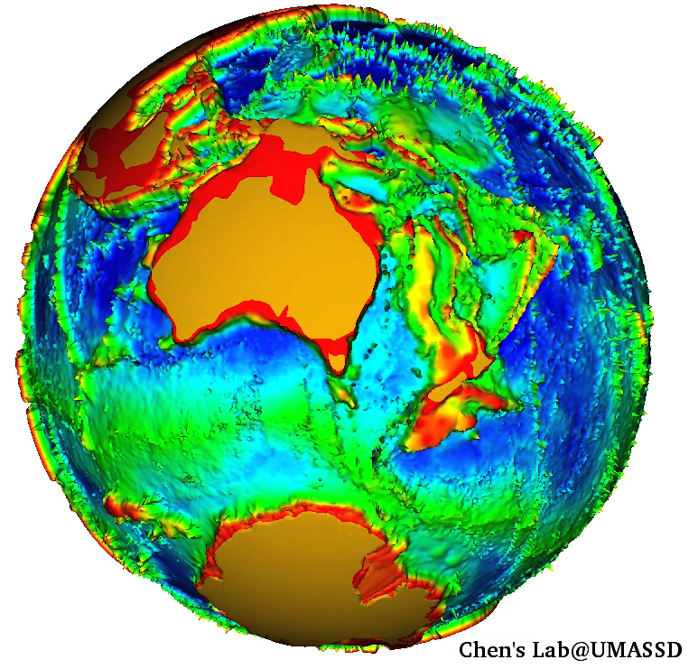
Surface Heating/Cooling
Q_{s}
Q_{b}
Q_{h}
Q_{e}
Q_{v}
Redistribute the heat
Q_{s}: The short wave energy radiated from the sun (the shortwave radiation)
Q_{b}: The net long-wave energy radiated back from the ocean (the longwave radiation);
Q_{h}: The heat loss by evaporation (latent heat flux);
Q_{e}: The sensible heat loss by conduction;
Q_{v}: The heat transfer by currents (advection and convection)

Slide 12
Vertical Penetration of Solar Radiation
Q_{s}
R, a and b depend on the water conditions. The penetration depth is large in the open ocean than the coastal ocean, in the clear water than the turbid water. It also varies with the plankton distribution. In the dense concentration area of plankton, the vertical penetration of solar irradiance is limited.
QS. How could we determine these parameters in an ocean model?

Slide 13
Wind forcing and Air Pressure
The surface wind stress is calculated using the wind velocity at the 10-m height above the sea surface:
Wind measurement
h_{m}
10 m
When we study the impact of cyclone or anti-cyclone on the ocean circulation, we also need to add the air pressure gradient forcing on the right-hand side of the momentum equations
L

Slide 14
Precipitation via Evaporation
With no precipitation via evaporation, the air-sea surface can be treated as a material surface. It means that all parcels at that surface remains there for ever.
The vertical velocity at the sea surface is equal to the change of the surface elevation
With precipitation via evaporation, the air-sea surface is not a material surface anymore.
The vertical velocity at the sea surface is equal to the change of the surface elevation plus the P-E flux.

Slide 15
Groundwater Flux
With no groundwater, the vertical velocity is characterized by the flow along the bottom topography. With groundwater flux, the vertical velocity changes due to the bottom flux.
H
Q_{b}

Slide 16
River Discharge
The river discharge is added into the model as the lateral flux condition.
Shelf
River
u
In the coastal region, the significant amount of freshwater enters the coastal region as non-point source. For example, the ice melting in spring, the wetland flux, etc. How to capture these water flux in a model is really challenging.
v

Slide 17
QS: How long ago did the idea for using numerical method to solve the partial difference equations appear?
A century ago? However, it has not been widely used until 70’s because of the limitation of computation capability.
QS: Who was the earliest modeler who devoted his life time on developing ocean model?
Dr. Kirk Bryan: Retired professor at Princeton University, who was named as the founding father of numerical ocean modeling. The Princeton General Circulation Model (GCM)-60’s
Professor Allan Robinson: Harvard University: Quasi-geostrophic ocean model-80’s
Dr. George Mellor: Princeton University: POM-later 80’s

Slide 18
QS: Why do we need to learn the numerical method since the future models could be operated like a Microsoft Window?
QS: There are so many mature ocean model available, so we could easily get one and run it as a black box. Why do we need to learn the basic principal used in numerical models?
QS: What is the best way to learn the numerical method?

Slide 19
Mathematical Classification of Flows and Water Mass Equations
Hyperbolic equations-----e.g.:
Parabolic equations----e.g.:
Elliptic equations---e.g.: .
Advective equation—e.g:
QS. Could we find examples of these 4 types of equations in the ocean science?

Slide 20
Example for a hyperbolic equation: Oceanic waves
Considering a 1-D linear surface gravity wave:
Solving these 2 equations for ζ:
then,
where

Slide 21
Example for a parabolic equation: Heat diffusion equation
Then, we get
Using the scaling analysis, we could find that the diffusion time scale is

Slide 22
Example for an elliptical equation: Pressure equation
Solving for P,
Then, we get

Slide 23
Example for an advective equation: Heat transport equation
This means that the local change of the water temperature is caused by the replacement of water advected from upstream direction
20º 18º 16º 14º
x
u > 0

Slide 24
Classification of Discretization Methods
Finite-difference methods---Oldest methods
Finite-element methods----Popular in the last 10 years
Finite-volume methods---New Methods

Slide 25
Difference between finite-difference, finite-element and finite-volume methods (FDM, FEM, and FVM)
FDM
FEM
FVM
i
i+1
Δx
Difference
Variance
Integration

Slide 26
Advantage:
Disadvantage:
FDM | Computational efficiency Simple code structures Mass conservation | Irregular geometric matching
FEM | Irregular geometric matching | Mass conservation Complex code structures Computational inefficiency
FVM | Combined the advantages of FDM and FEM | ??
FDM
FEM and FVM

Slide 27
Key Properties of Numerical Methods
1. Consistency
Definition: The discretization should approach the exact function as the discrete interval approach zero.
Example:
F(x)
F(x4)
F(x3)
F(x5)
F(x1)
F(x2)
Space interval:
x
x1 x2 x3 x4 x5... xn
as

Slide 28
2. Stability
Definition: A numerical method is defined to be stable if the numerical solution does not grow up an unreasonable big value or becomes infinite during the time integration.
f(t)
blows up !
o
t
Depending on: 1) time step/space resolution (linear), mass conservation and boundary conditions, etc
Comments: A stable model does not means that is mass conservative.

Slide 29
3. Convergence
A numerical method is defined to be convergent if the numerical solution of the discretization equation tends to reach the exact solution of the differential equation as grid spacing approaches zero.
f(t)
Oscillation
Exact value
Convergence
Non-convergence!
t

Slide 30
4. Conservation
The flow and water mass in the ocean follow the conservation laws. This means that in the absence of sources and sinks, the mass in local individual or global entire computational region should be conservative with a zero net flux into or out of the domain.
Finite-difference models: rectangular grids: conservative if specified care is made;
Finite-element models: Probably conservative over the entire domain but not individual element
Finite-volume models: Guarantee the mass conservation!

Slide 31
5. Boundedness
For the realistic application, there are bounds for flows and water masses. For example, the turbulent kinetic energy always remains positive. Currents, temperature and salinity, etc should have a maximum and a minimum values in individual volume. Boundedness means here that numerical solution should be within these values.
35
Examples:
U > 0
0
x
Δx
But the bounded minimum value is 0!
Depends on 1) Computer round off; 2) Order of Approximation
Comments: High order approximation scheme could easily cause the boundedness problem.

Slide 32
6. Realizability
Many processes in the ocean are too complex to have an exact solution which, we believe, is absolutely correct. For example, no one could say that the MY 2.5 turbulence closure model is sufficiently enough to describe the turbulence in the ocean, though we found it works for many cases. A numerical method should be developed with caution in considering resolving the reality.
Examples
Tidal simulation: The time ramping.
Similar: wind or other forcing.

Slide 33
7. Accuracy
Once the equations are discretized and solved numerically, they only provided an approximate solution. The accuracy of this solution depends on grid resolution and the orders of the approximation.
Examples:
Coarse grids: low accuracy
High order approximation: high accuracy but probably cause boundedness problems.
http://www.smast.umassd.edu:8080/thredds/fileServer/models/fvcom/NECOFS/course/MAR513/mar513.html

